Slide 1


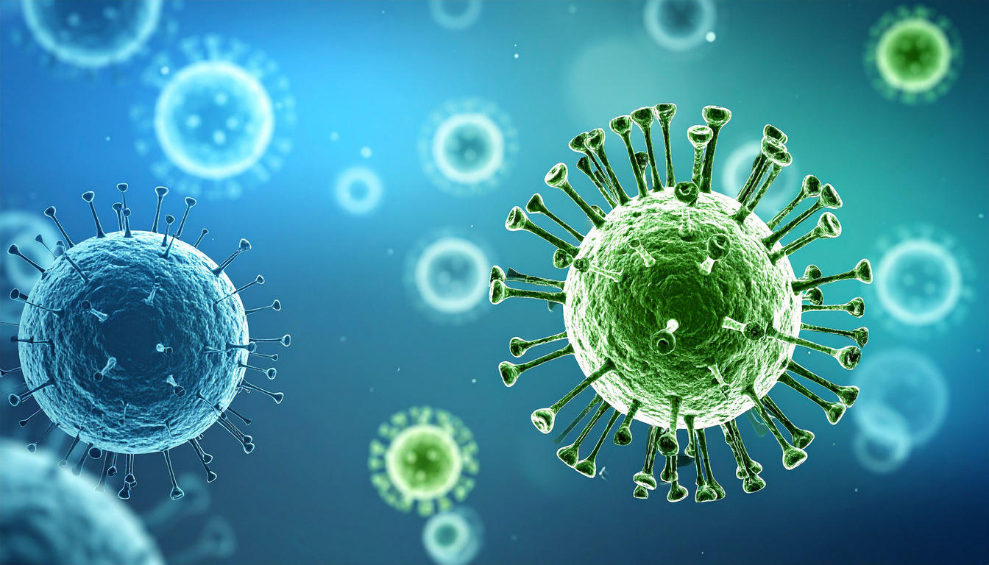




Leveraging Community Health Systems and Digital Tools for Continuous Community Nets Distribution: Pilot Study in Kirinyaga County, Kenya
W. Muguku^{1,2}, E. Ramaita², P. Mburugu², J. Katanu³, K. Njiru⁴, T. Ngugi⁴, J. Mwangi⁵, A. Kimaiyo⁵, K. Kibor²
¹KFELTP ; ²NMCP; ³DCHS, ⁴CHAI; ⁴Digital Health and Supply Chain Consultants
Public Health Interventions Towards Universal Health Coverage
Kenya Health Security Convention | 5th – 8th May 2026 | Mombasa - Kenya

Slide 2
Background
Use of insecticide-treated nets (ITNs) is the primary malaria control intervention (WHO, 2023)
Kenya uses two major distribution strategies to achieve universal coverage (KMS 2023-2027)
  Routine distribution for <1-year-olds and pregnant women
  Targeted mass net campaigns for households
In 2023/24, a digital system revolutionized Kenya’s mass net distribution
Bottlenecks:
  Current strategies not able to achieve equity
  Gradual decline in ITN coverage with time following campaigns
  Routine distribution lacks ITN replacement strategies
Notes:
Digitalization helped to achieve 94% ITN distribution coverage:
Real-time visibility improved accountability and transparency at all levels
Strengthened community engagement, accountability, and ownership
Strengthened trust among stakeholders, including implementing partners and state agencies

Slide 3
Objectives
Design and pilot an integrated digital continuous community net distribution (CCND) system that allows replacement of nets lost through attrition
  leverage Kenya's established Community Health Strategy and digital platforms
  Pilot the system to test the feasibility of workflow integrations
  Use the CCND to complement both routine distribution and mass net campaigns
Notes:
CHPs:
have direct insight into ITN gaps, changes in household composition and size, and create demand for ITN use
eCHIS:
-support service provision at the household level
-routinely registered households provide more natural data than pre-campaign registration data
Supersets:
Provide analytics and dashboards for service indicators and program indicators for decision-making at the subnational level
CHPs can reinforce behaviours that extend net lifespan, and facilitate timely replacement
ensures households maintain adequate protection throughout the three-year campaign interval

Slide 4
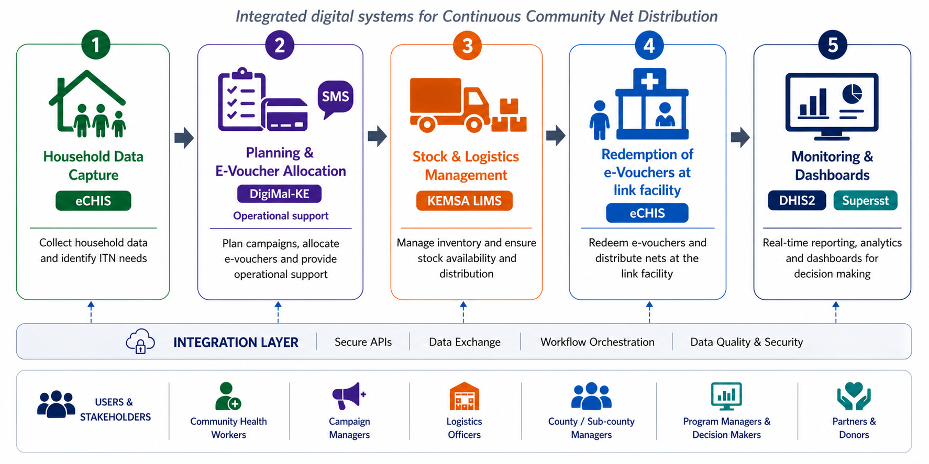
Methodology
  System Design and Development
Workflow Diagram generated using AI by Wachira Muguku, for illustrative purposes
Notes:
-integrated CCND system links household data from eCHIS to EMR at link health facilities and digital campaign planning in DigiMal, connects to KEMSA for real-time stock availability, enables e-voucher-based distribution, and feeds into DHIS2 dashboards for continuous monitoring and decision-making

Slide 5
Methodology
  Field Work and System Piloting
Kabare Ward, Kirinyaga East Subcounty, Kirinyaga County –Purposively selected
  3 Community Health Units
  ITNs quantified and allocated at selected CHU Link facilities
  User acceptance testing, Community sensitization, user mapping and training
Data collection
  Household ITN assessments and referrals by CHPs
  Redemption of e-vouchers by households and issuance by CHAs
  Reporting and analytics through system dashboards

Slide 6
Results
  ITN Need Assessment Statistics
CHU | Total Households Registered in eCHIS | Households Assessed for ITNs | Proportion (%) | People in Assessed Households | Average Household Size | #ITNs Available in Assessed Households | Pregnant Women Referred for ITN | Children <1 year Referred for ITN | No. of eVouchers generated
Kiritini | 944 | 401 | 42.5 | 1060 | 2.6 | 25 | 6 | 12 | 376
Mikarara | 868 | 389 | 44.8 | 808 | 2.1 | 1 | 0 | 1 | 386
Rukenya | 1005 | 407 | 40.5 | 1255 | 3.1 | 39 | 2 | 9 | 394
Total | 2817 | 1197 | 42.5 | 3123 | 2.6 | 65 | 8 | 22 | 1156

Slide 7
Results
  ITN Distribution Statistics

Slide 8
Discussion
  Automation of e-vouchers allowed households to receive a notification through phones and CHA at facility to check their stock levels
  Dashboards allowed tracking of ITN coverage indicators at all levels
  CHPs could identify repairable ITNs using simplified WHO’s PHI criteria; however, they lacked repair kits to facilitate practical demonstrations of ITN mending
  ITNs for pregnant women and <1year-old children were issued outside the system because CCND was not linked to hospital electronic medical records (EMR)
  Registered household sizes were smaller than actual sizes

Slide 9
Conclusion
  Digital integration improves efficiency, accountability, and decision-making in continuous ITN distribution
  Linking each ITN to a verified household in eCHIS enhanced accountability and transparency at all levels
  Leveraging on the existing community health strategy, CCND provides an opportunity for continuous replacement of ITNs and offering continuous protection

Slide 10
Policy Impact and Implications
  CCND can complement mass campaigns and routine ITN distribution to sustain universal ITN coverage
  The pilot highlights the need for strengthening eCHIS data completeness and household coverage before scale-up to more counties and completing EMR loop
  In the long term, CCND may replace mass net campaigns as a community-anchored strategy that can achieve equitable ITN coverage
Notes:
-building on insights from the small-scale CCND pilot, next phase to expand implementation to larger geographic area
-to test and refine the eCHIS workflows, strengthen system performance, and ensure the platform is fully optimized before national scale-up

Slide 11






Thank you!
Scan to visit our website
#KeHSCon2026
@NPHIKenya
www.nphi.go.ke

